Slide 1
Nodejs CLI

Slide 2
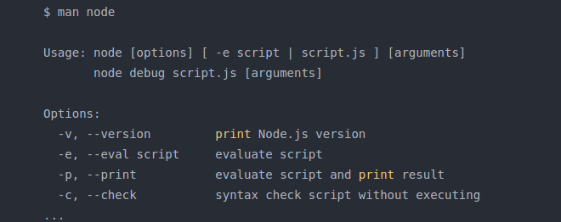
Accessing Node.js CLI Options
Node.js comes with a lot of CLI options to expose built-in debugging & to modify how V8, the JavaScript engine works.
To get a full list of all available Node.js CLI options in your current distribution of Node.js, you can access the manual page from the terminal using:

Slide 3
CLI Options
--version or -v
--eval or -e
--print or -p

Slide 4
CLI Options
--check or -c
The --check option can come handy, when you want to see if your script is syntactically correct, without executing it.
Lot of CLI option are also there check it out by yourself.

Slide 5
using npm for dependency management

Slide 6
What is npm?
npm is the package manager for Node.js.
It was created in 2009 as an open source project to help JavaScript developers easily share packaged modules of code.
The npm Registry is a public collection of packages of open-source code for Node.js, front-end web apps, mobile apps, robots, routers, and countless other needs of the JavaScript community.
npm is the command line client that allows developers to install and publish those packages.
npm is often used by developers and IT people who don't use (program with) Node.js at all.

Slide 7
npm CLI commands
npm init
Interactively create a package.json file
Description
This will ask you a bunch of questions, and then write a package.json for you.
It attempts to make reasonable guesses about what you want things to be set to, and then writes a package.json file with the options you've selected.
If you invoke it with -f, --force, -y, or --yes, it will use only defaults and not prompt you for any options.

Slide 8
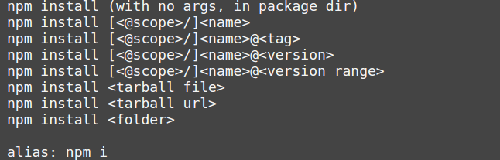
npm CLI commands
npm install

Slide 9
npm CLI commands
npm start
Description
This runs an arbitrary command specified in the package's "start" property of its "scripts" object.
If no "start" property is specified on the "scripts" object, it will run node server.js.

Slide 10
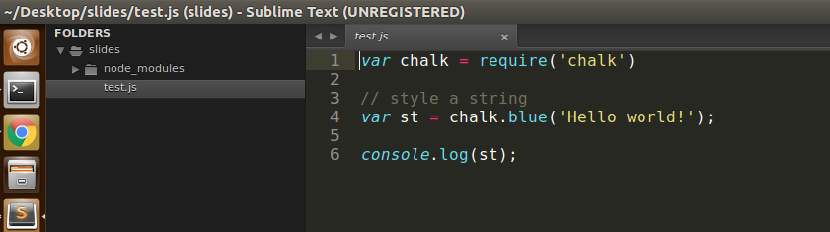
Local Packages
Packages can be installed locally, to be used in your projects.
$ npm install chalk
This will create the node_modules directory in your current directory (if it doesn't exist yet), and will download the package to that directory.
To use the installed package require it on your script.

Slide 11
Local Packages
Another way to manage npm packages locally is to create a package.json file.
You can create it manually or by using
$npm init
you can use the --save flag.
This will download the package as before, but will also add it to the dependencies in package.json.
If you have a package.json file in your directory and you run npm install, then npm will look at all the dependencies and download them in node_modules.
This is nice because it makes your build reproducible, which means that you can share it with other developers.

Slide 12
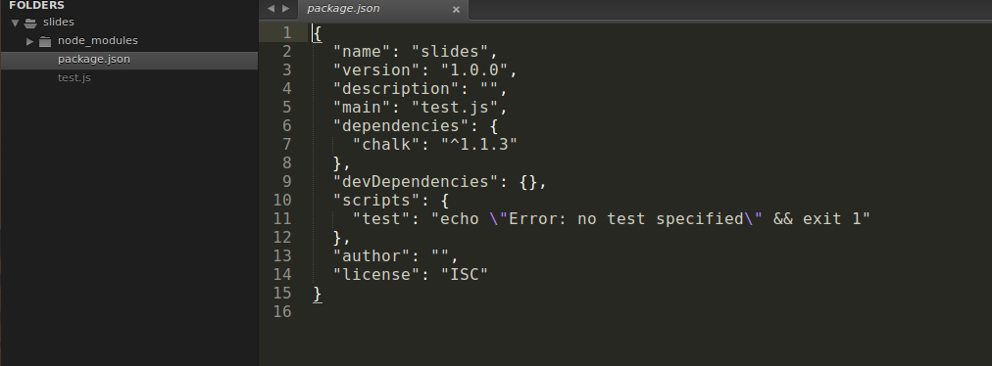
package.json

Slide 13
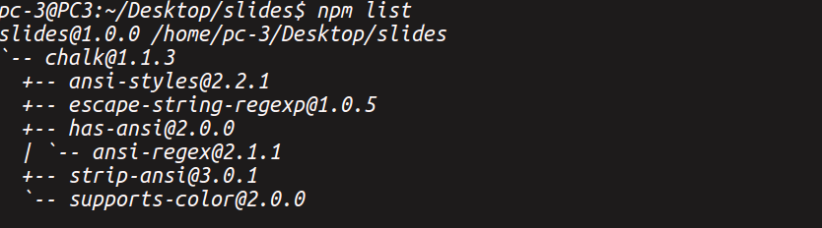
Listing Local package
$npm list

Slide 14
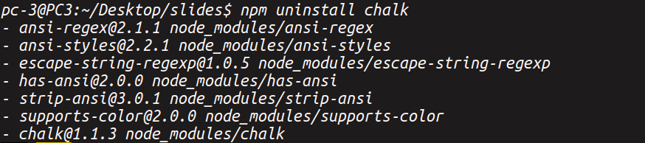

Uninstalling Local Packages
$npm uninstall

Slide 15

Installing a Specific Version of a Package

Slide 16
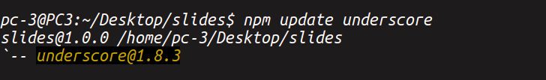

Updating a Package

Slide 17
NodeJs in-built Modules
Http To make Node.js act as an HTTP server
Fs To handle the file system

